Slide 1
Python week 3
Canberra Chinese School Sem1

Slide 2
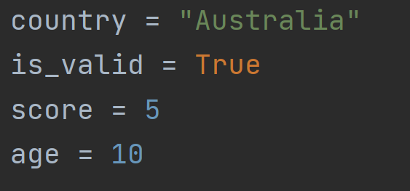
A Quick Review
For i in list:
do something
Is equal to:

Slide 3

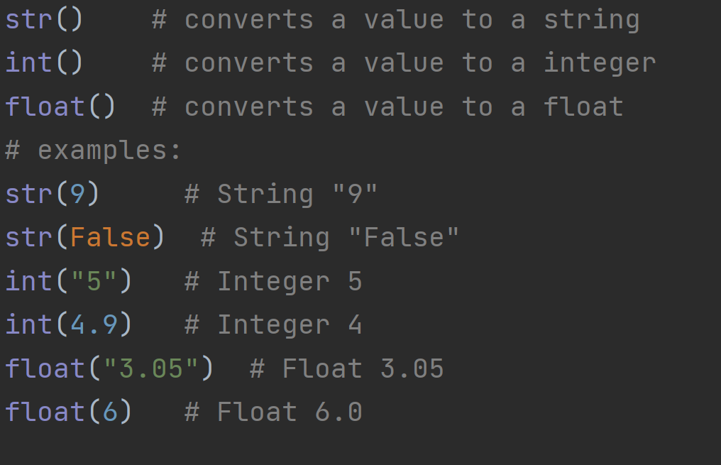
Review

Slide 4

Review

Slide 5
Lists
A list is a box that stores multiple variables.
A list starts with the 0th element. The first element in a list is the 0th, not 1st
Thus, the first element is denoted the index 0 element.
The second element is the index 1 element.
And so on.

Slide 6
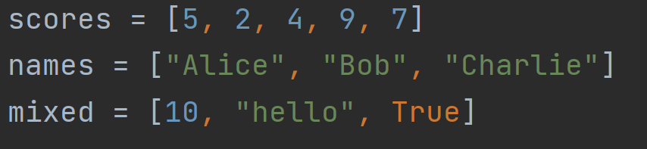
Lists

Slide 7
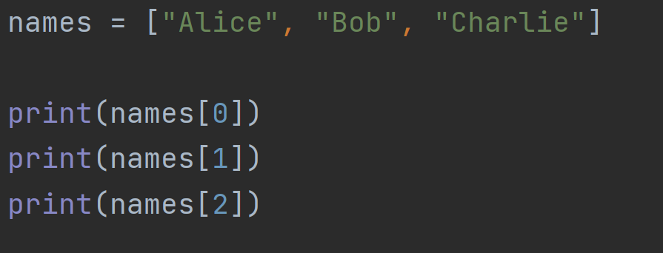
Lists
names[n] denotes the index n element, or the
(n+1)th element in the list

Slide 8
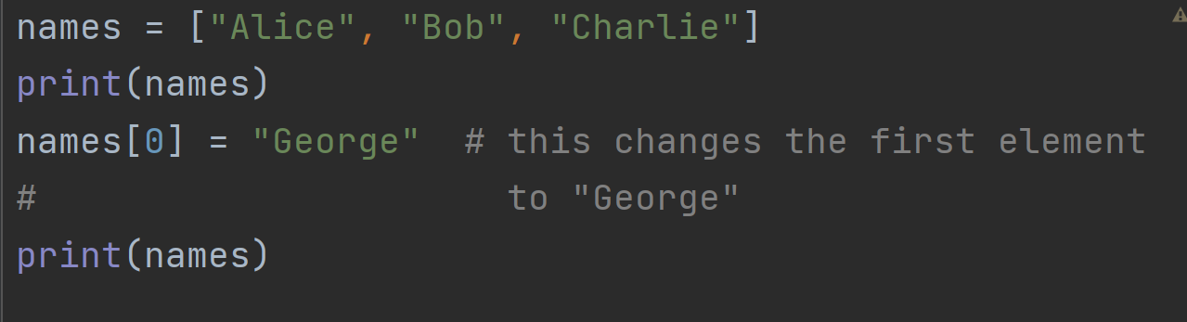
Lists
You can change the first element of the list like this.

Slide 9

Quiz 1
Answer: D
What is
A. “e”
B. “cloudy”
C. “weather2”
D. “rainy”

Slide 10


Quiz 2
Answer: “door”
What is
What is
Answer: doesn’t exist

Slide 11
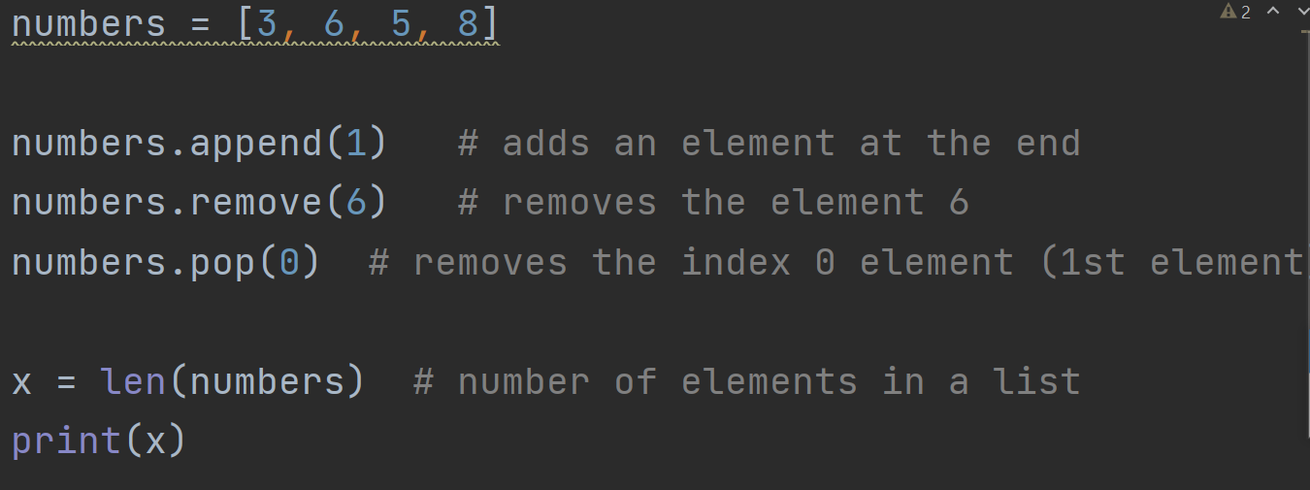
Lists operations

Slide 12
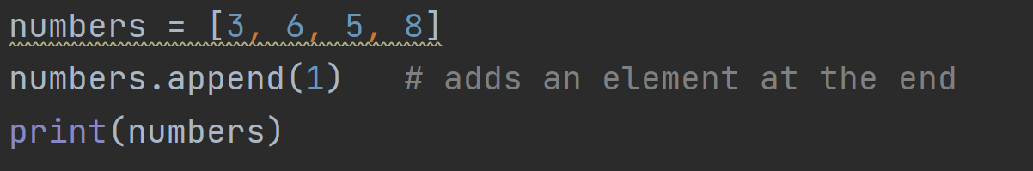
Quiz 3
Answer: B
What will be printed?
A. 1, 3, 6, 5, 8
B. 3, 6, 5, 8, 1
C. 3, 6, 5, 8, 3
D. 3, 6, 5, 8, 3, 6, 5 ,8

Slide 13
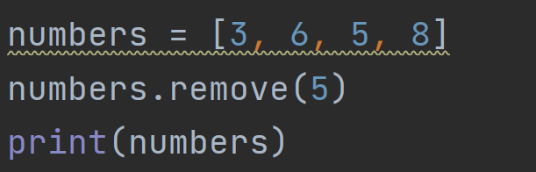
Quiz 4
What will be printed?
Answer: 3, 6, 8

Slide 14
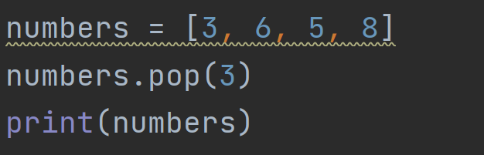
Quiz 5
What will be printed?
Answer: 3, 6, 5

Slide 15
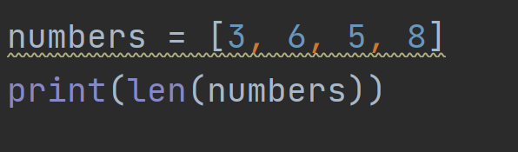
Quiz 6
What will be printed?
Answer: 4

Slide 16
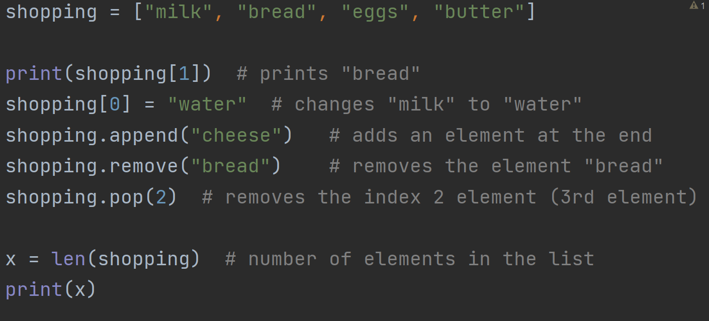
Summary

Slide 17
Exercise
Mom has given you a shopping list
But she decided to:
Buy olive oil instead of butter
Not buy bread
Add “broccoli” to the list
Your task is to use whatever we learned today,
Convert shopping to:

Slide 18
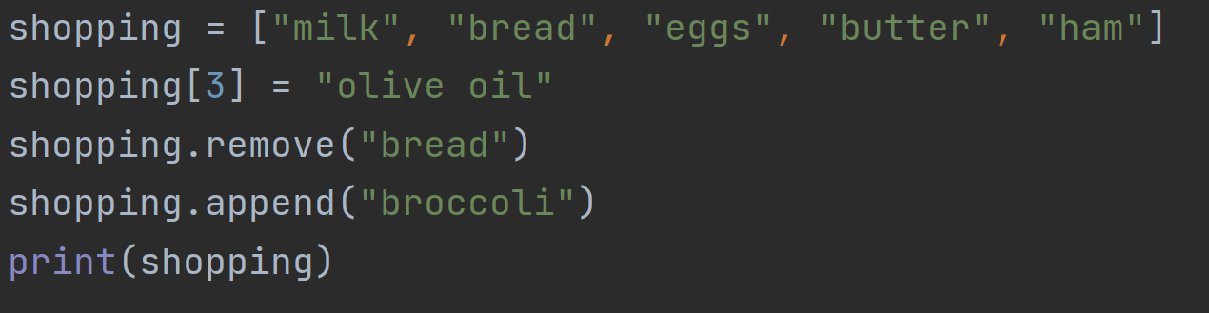
Exercise answer

